Slide 1
STREAMING MUSIC ANALYSIS
Eric Meyer, Kristen Scaletta and Michelle Simek
Notes:
All introduce

Slide 2
Agenda
Project overview
Methodology
Analysis
Challenges and Next Steps
Notes:
Eric 2-6

Slide 3
Project Overview and Key Questions

Slide 4
Project Overview
This project explores relationships between top streamed music and song attributes, as well as rank by country and overall.
Hypothesis 1: Artists ranked higher overall are consistently ranked higher in individual continents. (Higher being closer to 1.)
Hypothesis 2: More popular and better ranked artists tend to have higher energy, danceability, loudness and tempo.

Slide 5
Key Questions
?
How does top artists’ rank across continents compare to their global rank?
Is there a relationship between “musicalities” and popularity by country (as defined by Spotify)?
Is there a relationship between “musicalities” and average artist rank?

Slide 6
Definitions of Musicalities
Danceability: Describes how suitable a track is for dancing based on a combination of musical elements including tempo, rhythm stability, beat strength, and overall regularity.
Valence: Describes the musical positiveness conveyed by a track. Tracks with high valence sound more positive (e.g. happy, cheerful, euphoric), while tracks with low valence sound more negative (e.g. sad, depressed, angry).
Energy: Represents a perceptual measure of intensity and activity. Typically, energetic tracks feel fast, loud, and noisy. For example, death metal has high energy, while a Bach prelude scores low on the scale.
Tempo: The overall estimated tempo of a track in beats per minute (BPM). In musical terminology, tempo is the speed or pace of a given piece, and derives directly from the average beat duration.
Loudness: The overall loudness of a track in decibels (dB). Loudness values are averaged across the entire track and are useful for comparing relative loudness of tracks.
Source: https://towardsdatascience.com/what-makes-a-song-likeable-dbfdb7abe404#:~:text=Valence%3A%20Describes%20the%20musical%20positiveness,measure%20of%20intensity%20and%20activity

Slide 7
Methodology
Notes:
Michelle 7-13

Slide 8
Methodology
Data Gathering
Data Cleaning
Analysis
Collected data on top songs from May 2020 and musicalities from the 1920s to today in two .csv files, both generated using Spotify data (Source: Kaggle)
Process: [1] Combined data sets on artist name—needed to clean some data to get matches. [2] Grouped by artist name to get means. [3] Initially removed global rankings
Concerns: Not all artists may match
Using the cleaned data, developed charts to test each key question.
Depending on the result, adjusted chart for further exploration or better display.

Slide 9
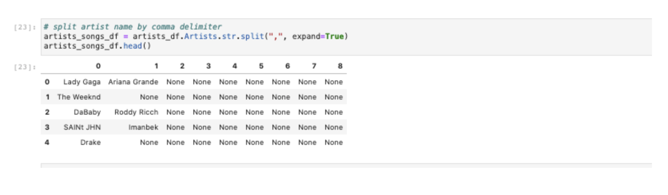
Data Cleaning
Challenge 1: Sometimes multiple artists were listed per song. We split the column to pull the primary (first artist).

Slide 10
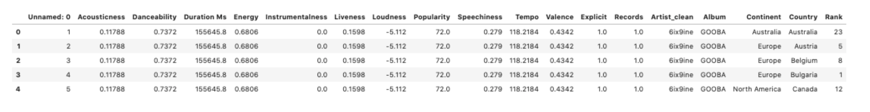
Data Cleaning
Challenge 2: Combine data sources by doing an inner merge on artist name.

Slide 11
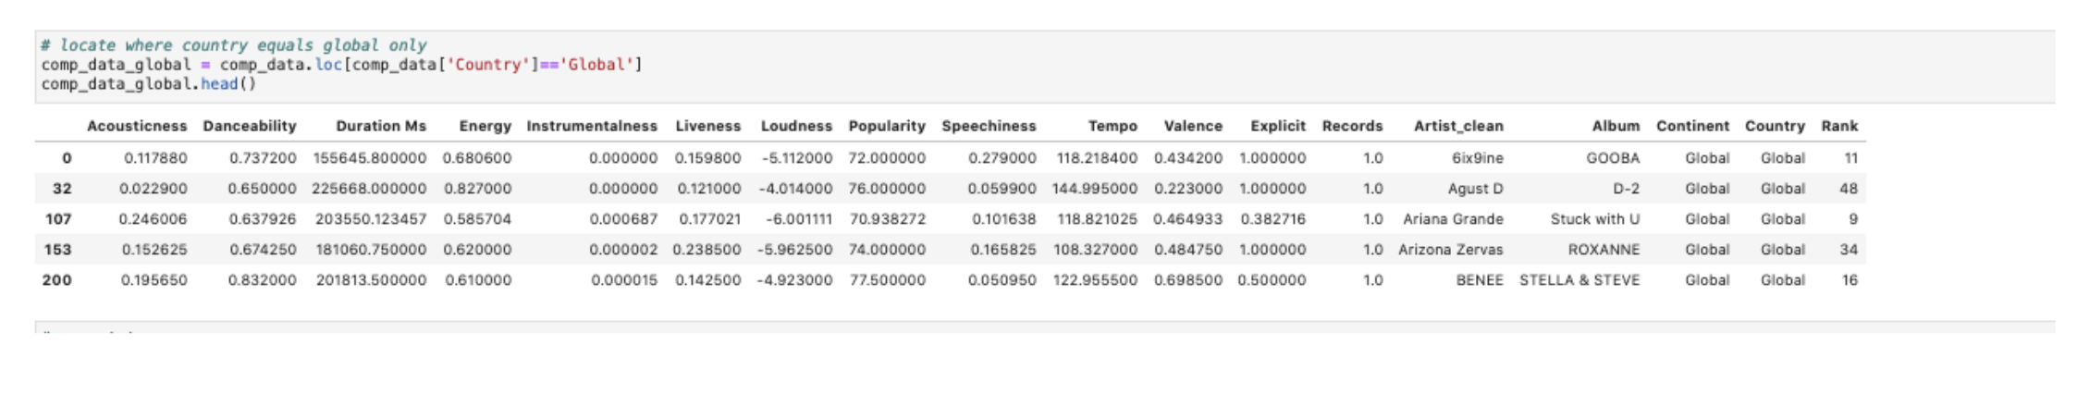
Data Cleaning
Challenge 3: Create new dataframe with global data and remove global data from dataframe created in challenge 2 in order to compare artists at the global vs continent or country levels.

Slide 12
Analysis of Key Questions

Slide 13
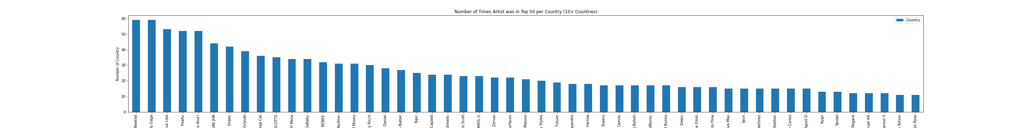
Question 1: How does top artists’ rank across continents compare to their global rank?
Started by looking at how many times each artist was listed in the top 10 charts for each country. For example, The Weeknd was in the top charts for 59 countries.

Slide 14
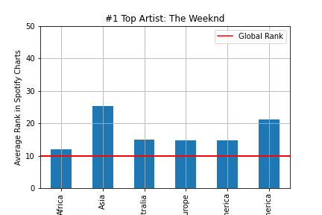
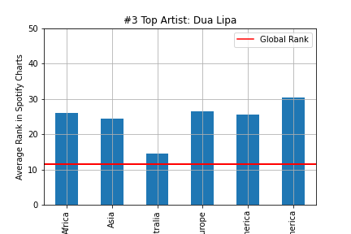
Question 1: How does top artists’ rank across continents compare to their global rank?
Looked at the top 10 artists ‘ ranks averaged by continent in which they are ranked compared to how they are ranked globally. Here, you can see The Weeknd and Dua Lipa for examples.
Findings: In this case, it appears the Weeknd and Dua Lipa are ranked higher globally (between 10 and 15) than in any continent. We then explored this discrepancy.

Slide 15
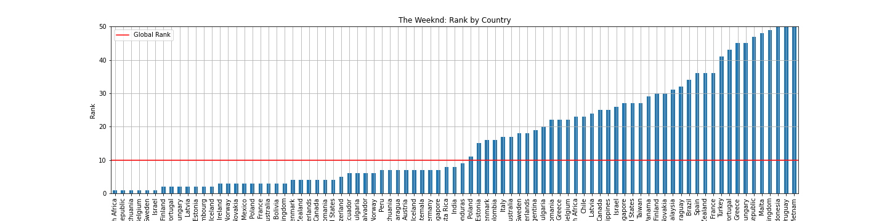
Question 1: How does top artists’ rank across continents compare to their global rank?
Looked at The Weeknd’s rank averaged by country in which he is ranked compared to how he was ranked globally.
Findings: When looking at each country, the average of countries within a continent being higher than the an artist’s global rate makes sense given the variance.

Slide 16
Question 1: How does top artists’ rank across continents compare to their global rank?
Overall Analysis: Just because you are ranked high globally doesn’t mean you’re ranked high (meaning closer to 1) in every individual country.

Slide 17
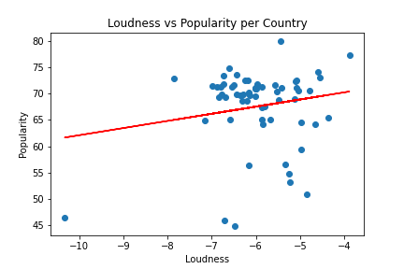
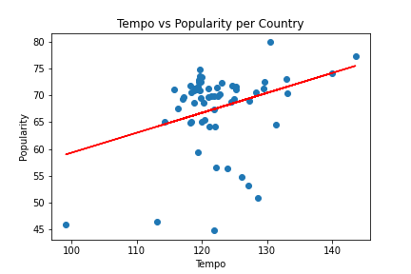
Question 2: Is there a relationship between “musicalities” and popularity by country?
Compared popularity by country to various musicalities for artists ranked in the top 10 on average. Popularity is Spotify’s proprietary metric.
The r-squared is: 0.031701428805754904
Findings: It appears there may be a positive correlation between loudness and popularity.
The r-squared is: 0.10274161293471054
Findings: There appears to be a positive correlation between tempo and popularity. Looking further into the cluster would be interesting.
Notes:
Eric 14-16

Slide 18
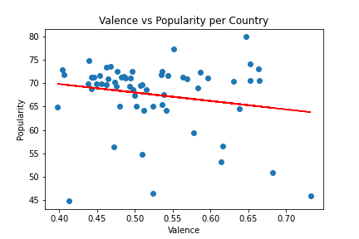
Question 2: Is there a relationship between “musicalities” and popularity by country?
Compared popularity by country to various musicalities for artists ranked in the top 10 on average. Popularity is Spotify’s proprietary metric.
The r-squared is: 0.03547623651451005
Findings: There appears to be a weak negative correlation between valence and popularity.

Slide 19
Question 2: Is there a relationship between “musicalities” and popularity by country?
Overall Analysis: When looking at music “likability” across countries, both Tempo and song Loudness seems to correlate with a song’s popularity. Tempo is clustered around 120bpm and loudness between -7 and -6. Valence, a ranking if a song is happy (higher valence) or sad (lower valence), doesn’t seem to have a strong correlation across countries by popularity and there doesn’t seem to be any apparent valence clusters.

Slide 20
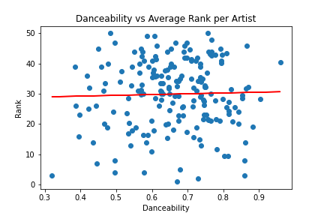
Question 3: Is there a relationship between “musicalities” and average artist rank?
Compared average artist rank to various musicalities for artists whose average rank is less than or equal to 10.
The r-value is: 0.0007640423231120749
Findings: It appears there may be a very weak positive correlation between danceability and rank suggesting lower ranked songs (farther away from 1) may have more danceability. However, this correlation doesn’t appear to be significant so additional exploration is needed.
Notes:
Kristen 17-23

Slide 21
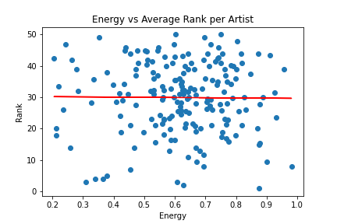
Question 3: Is there a relationship between “musicalities” and average artist rank?
Compared average artist rank to various musicalities for artists whose average rank is less than or equal to 10.
The r-value is: 9.579366500530684e-05
Findings: There appears to be a very weak negative correlation between energy and popularity, suggesting higher ranked songs (being closer to 1) may have more energy. However, this correlation doesn’t appear to be significant so additional exploration is needed.

Slide 22
Question 3: Is there a relationship between “musicalities” and average artist rank?
Overall Analysis: We did not see strong correlations between artist rank, danceability and energy. We also did not see any clear clusters between either musicalities in the data sets.

Slide 23
Discussion and Next Steps

Slide 24
Discussion
Hypothesis 1: Artists ranked higher overall are consistently ranked higher in individual continents. (Higher being closer to 1.)
Based on this analysis, it appears there is some merit in this statement and it would be worth further exploration. This analysis shows that when artists are ranked closer to 1 globally, this is not indicative of country rankings. More research into how rankings are calculated globally and by country could be interesting to see if there is a different method.
Hypothesis 2: More popular and better ranked artists tend to have higher energy, danceability, loudness and tempo.
There appears to be some correlations when looking at popularity but not when looking at rank. Perhaps bucketing musicalities into broader song categories (like genre) and seeing which together tend to result in more popular or higher ranked songs could be interesting. Also, looking at the same musicalities for popularity and rank may help.

Slide 25
Challenges
Time frames of data sources didn’t necessarily correlate so we may not have been looking at apples to apples. For example, the data with musicalities spanned decades whereas the top artist data was from May 2020.
Rank and popularity in different countries are dependent on a number of possible variables (for example population, number of Spotify users, etc.)
Would need more information on how Spotify calculates all of its variables.

Slide 26
Next Steps
To continue the research, in addition to what was already discussed, we could:
Look at different date ranges since the musicality data was from May 2020 and the artist rank data was inclusive of May 2020 but a broader time range.
Dig deeper into each country’s musicality preferences vs a global picture.
Include genres.

Slide 27
Questions?
?
Thank you for listening!

